Slide 1
COINS Course Group Work - Tips on How to Succeed

Slide 2
Agenda
Working in a Globally Distributed and Multi-disciplinary Team – Tips
Iterations
Communication recording
Surveys
Evaluation

Slide 3
Working in a Globally Distributed and Multi-disciplinary Team - Tips

Slide 4




Working in a Globally Distributed and Multi-disciplinary Team - Tips
…is not easy!
Some Tips:
First: Get to know each other
Who you are, hobbies, background etc.
“Take the time to get to know your team members on a personal level. Short chats at the beginning of meetings were nice.”

Slide 5

Some Tips, continues…
Second: Discuss project and personal goals
Discuss: what you could / would like to contribute to the project, what you would like to learn during the project
Discuss: project goals and scope with all stakeholders (Customer, mentor, team members…). Do not expect everybody understands the goals the same way!

Slide 6
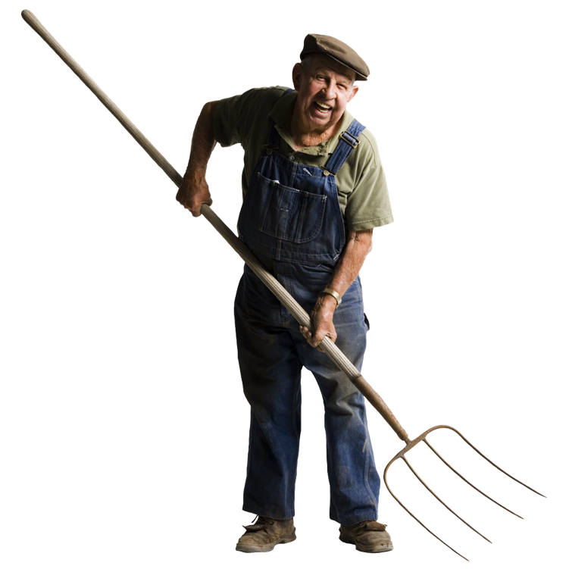
Some Tips, continues…
Third: Discuss the way of working:
Decide regular meeting slots beforehand (e.g. 2 meetings per week)
Write down what is decided in each meeting
Common repository (e.g. dropbox, google docs, etc.)
Communication
Communicate often & answer fast
Prefer synchronous communication if possible (Skype, Slack, chats…)
Common calendar?
Let other each other know when you have time to work and when not (e.g. exams)
Promise only what you can deliver
Tell others about any problems and ask for help right away
Pair work?

Slide 7
Iterations

Slide 8
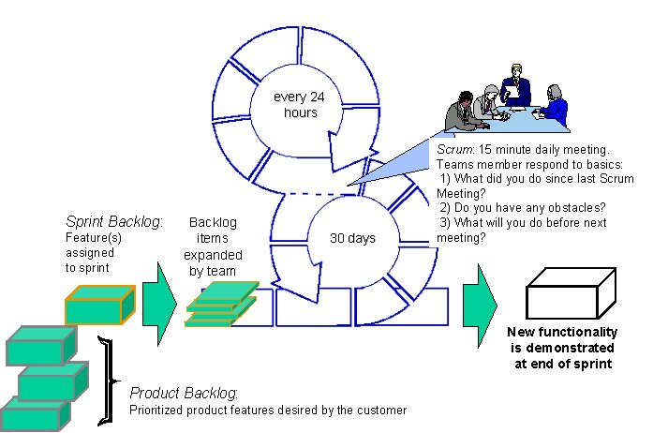
Iteration
We apply Scrum phases in each iteration
Iteration planning Part 1 (WHAT with customer/mentor) + Part 2 (HOW)
Daily Scrums (sugestion:bi-weekly)
Retrospective: keep, drop, try in next iteration
Demonstration in Virtual Meetings

Slide 9
Iterations
Iteration 1: April 17 - project status
Iteration 2: April 24 - project status
Iteration 3: May 8 – project status
Iteration 4: June 5 - virtual mirror
Iteration 5: June 26 - project status
Iteration 6: July 17 - final presentation

Slide 10
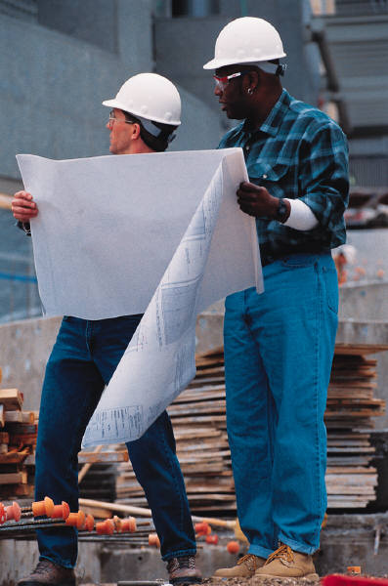
1. Iteration
After the 1. iteration you will present:
Team Members
Your goals (scope)
Overall project plan
Plan for the first iteration
Your way-of-working

Slide 11
Template for Presentations
Goals of the project
Progress during the last iteration: explain what was done
Show the main results
Goals and plans for the next iteration
Output from the retrospective
Problems / questions?

Slide 12
Communication recording

Slide 13
Communication recording
Cc all email communication to the cc-address of your project (coinprojectX@gmail.com) X={1..n}
Face-to-face / virtual meetings: ONE email to the whole team, including
label it “f2f” in subject line (send it right away after the meeting)
In the email body:
Participants: Who was present?
Start & Finish Date and Time
Outcome: Main decisions made
Also informal pair meetings etc.
You will need this when analyzing your own team’s communication (after iteration 2)

Slide 14
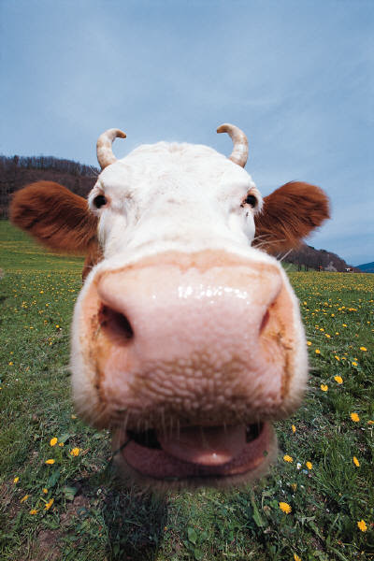
Questions?

